Slide 1
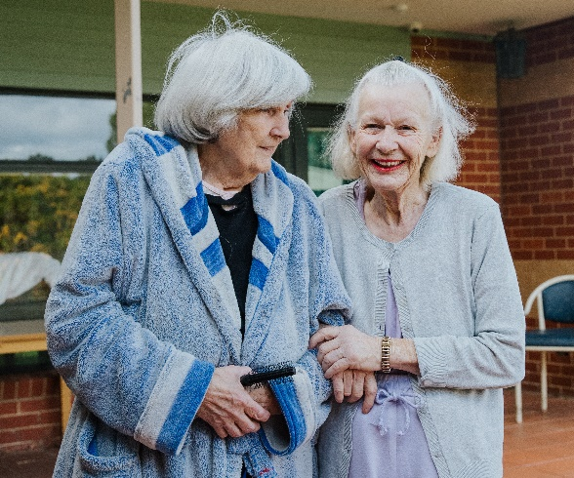

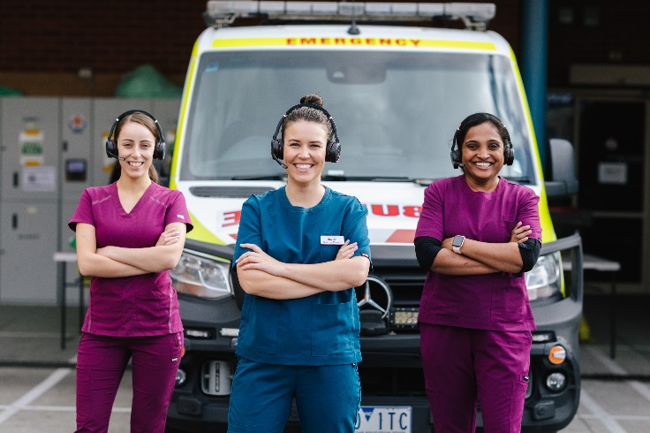
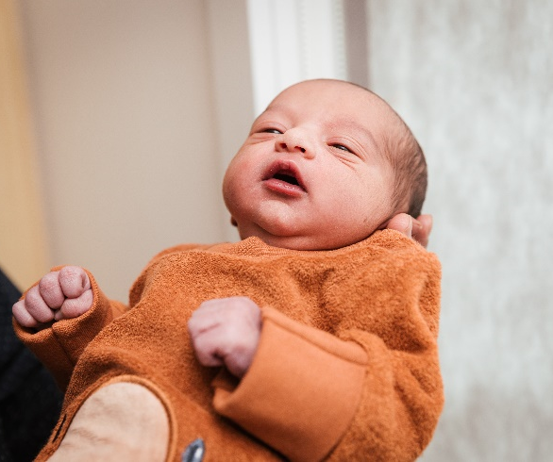
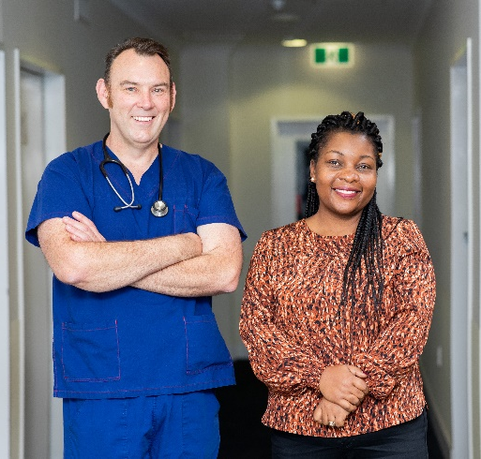


Perioperative Digital Care Pathway
Yvette Sage
Thursday 10th October 2024

Slide 2
About Me
Education: Bachelor of Nursing (RN) with a post-grad in Perioperative Nursing
Career: Northern Health→ Austin Health → Northern Health
Interests: Family, baking, travel

Slide 3
Standards
This presentation is aligned with the following NSQHS Standards:
  Partnering with consumers
  Comprehensive Care
  Communicating for Safety

Slide 4
Key points
Why use a Perioperative Digital Care Pathway (DCP)?
What is the Periop DCP?
Onboarding process
Future vision

Slide 5
Perioperative DCP – Why?
Utilization of waiting period
Improve patient health and improve surgical outcomes
Surgery School
Empowering patient self management
Reduction in day of surgery cancellations
Reduced complications
Reduced length of stay
Quicker recovery / return to home environment

Slide 6
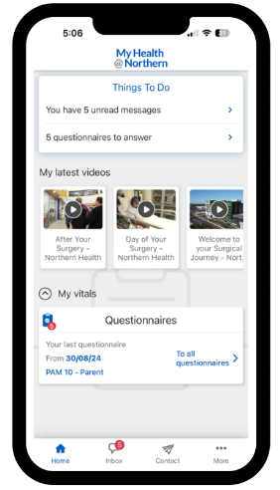
What is the Perioperative DCP?
PATIENTS:
Patient App
Platform for:
Educational resources for patients – Videos, PDFs
Questionnaires
Contact details
Automated messages
Currently live for Surg 1, 2, 3 4 patients, English speaking

Slide 7
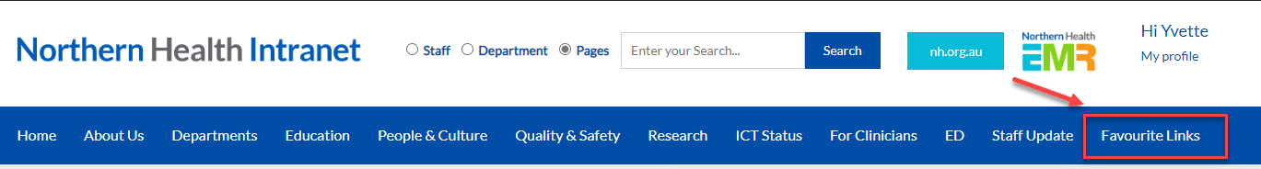

What is the Perioperative DCP?
CLINICIANS
Favourite Links

Slide 8
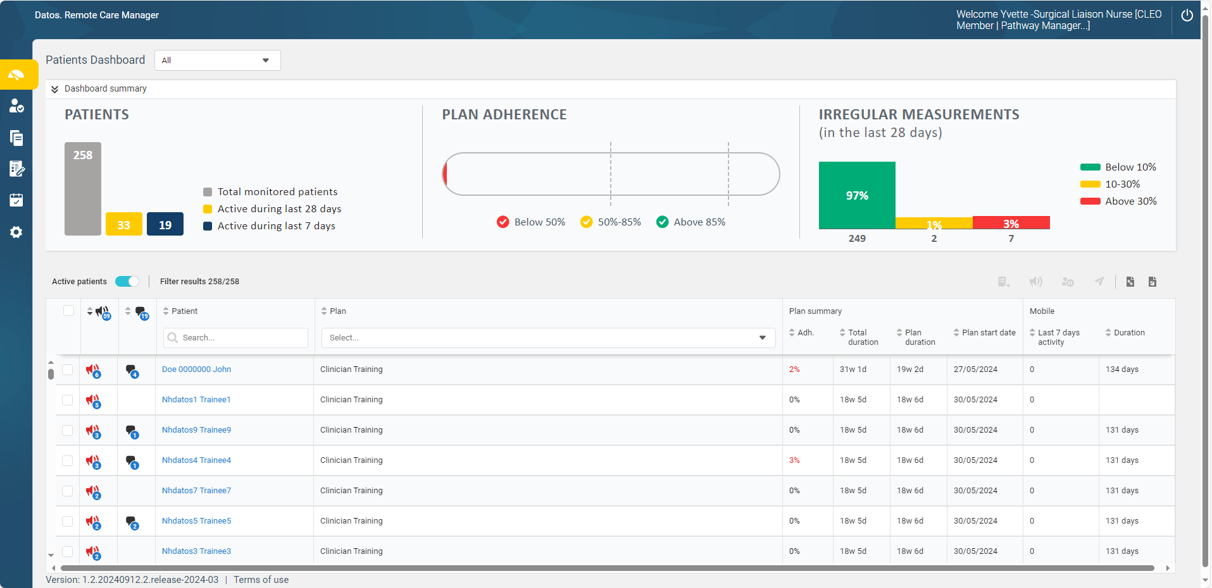
Clinician Dashboard

Slide 9







Onboarding Process
+/- Preadmission
Notice of admission
Waitlist
Surgery Date
Surg 1
Cat 1: 9 days average
Cat 2: 38 days average
Cat 3: 134 days average

Slide 10
Demonstration

Slide 11
Future Phases
All specialties / All campus
Specific Pathways
- Paediatric Tonsillectomy / Adult tonsillectomy
- Laparoscopic Gynaecology
Preadmission Health Questionnaire
Surgical Appointments - Surgery Date / Preadmission Appointment
Post-op Education
Post-op follow ups
Preadmission Tele Health – non mobile patients

Slide 12
Links
Welcome to your Surgical Journey https://vimeo.com/995271192
Your Pre-admission clinic https://vimeo.com/995271235
Day of your surgery https://vimeo.com/995271271
After your surgery https://vimeo.com/995271347
Managing your diabetes https://vimeo.com/1006429053/c6c66ba75a?share=copy
Understanding Iron Deficiency and Anaemia https://vimeo.com/1006023516/a23bc49b5a
Quit Smoking https://vimeo.com/1016849664
Exercise https://vimeo.com/1016849619
ACOUGH / Deep breathing: https://vimeo.com/1016849643
PROMS: https://vimeo.com/996055261
Shared decision making: https://vimeo.com/996057829

Slide 13

Thank you!
WE VALUE YOUR FEEDBACK!
Please complete the evaluation.
i-phone – just point camera
Android – use QR reader app
Or use this link: https://www.northerndoctors.org.au/education-session-feedback-form/

