Slide 1







Good Documentation: Tips & Tricks
Intern Teaching
Tuesday 20th August 2024
Mary Kouvas – Clinical Documentation Integrity Coordinator/Health Information Manager

Slide 2
Medtasker
Please divert your Medtasker during protected Intern Education

Slide 3
Today’s interactive session will cover:
What is clinical coding and why is it performed?
EMR – discharge summary and progress note tips
Let’s code a record together
CDI queries via Medtasker - feedback
Tips and Tricks in documentation
Competition Question: abbreviation

Slide 4
Clinical Coding & Documentation
Translates medical statements into codes. Describes the episode of care.
Relevant to inpatients only. Not Outpatients or ED.
Similar types of patients are grouped into like categories called DRGs.
IHACPA – Independent Health and Aged Care Pricing Authority.
Acute care type = Activity Based Funding model. Now Mental Health and some GEM patients (FY24/25).
Funding, about 70% ABF, rest additional grants and other funds (prosthesis).
Research, service planning, quality, etc – monthly data submissions to Dept of Health.
Clinical coders rely on clear and accurate clinical documentation.
https://youtu.be/VZ1Wvb0dvGI

Slide 5
EMR Tips

Slide 6
EMR – General Tips
Discharge summary
Select Principal Diagnosis and Additional Diagnoses.
Read QRGs or contact EMR if you require help with discharge summaries.
Major issue is lack of PDx on d/s.
Progress notes
Think about what you need to copy+paste. Is the impression still an impression or do you have an actual dx?
Think about what you will find helpful when reading other’s notes.
Do you really want to read chunks of the same thing?
What’s new, what’s current, what has been resolved?
Refer to EMR QRGs or ask for help.

Slide 7
Discharge Summary - Tips
Principal Diagnosis
From problem list, select Principal and refresh in d/s.
Can only be one. Responsible for DRG assignment.
Additional Diagnosis
From Problem list “Diagnosis” will appear on right-hand side of d/s.
No need to be exhaustive in this section.
List each issue/diagnosis in body of Inpatient Summary, assessments/results linked to.
Procedures
A summary of each intervention performed.
If simple or elective surgery, a full version of the operation is fine. (Check with Kim if this is what GPs prefer).
Problem List – Ongoing and Historical
Ensure past hx is updated.
Needs to be in problem list so AI and data mining can happen effectively.
Patient’s past hx is always available and must remain current. Saves time with representing patients.
Previously documented as past hx in notes and not stored in one centralized section.

Slide 8
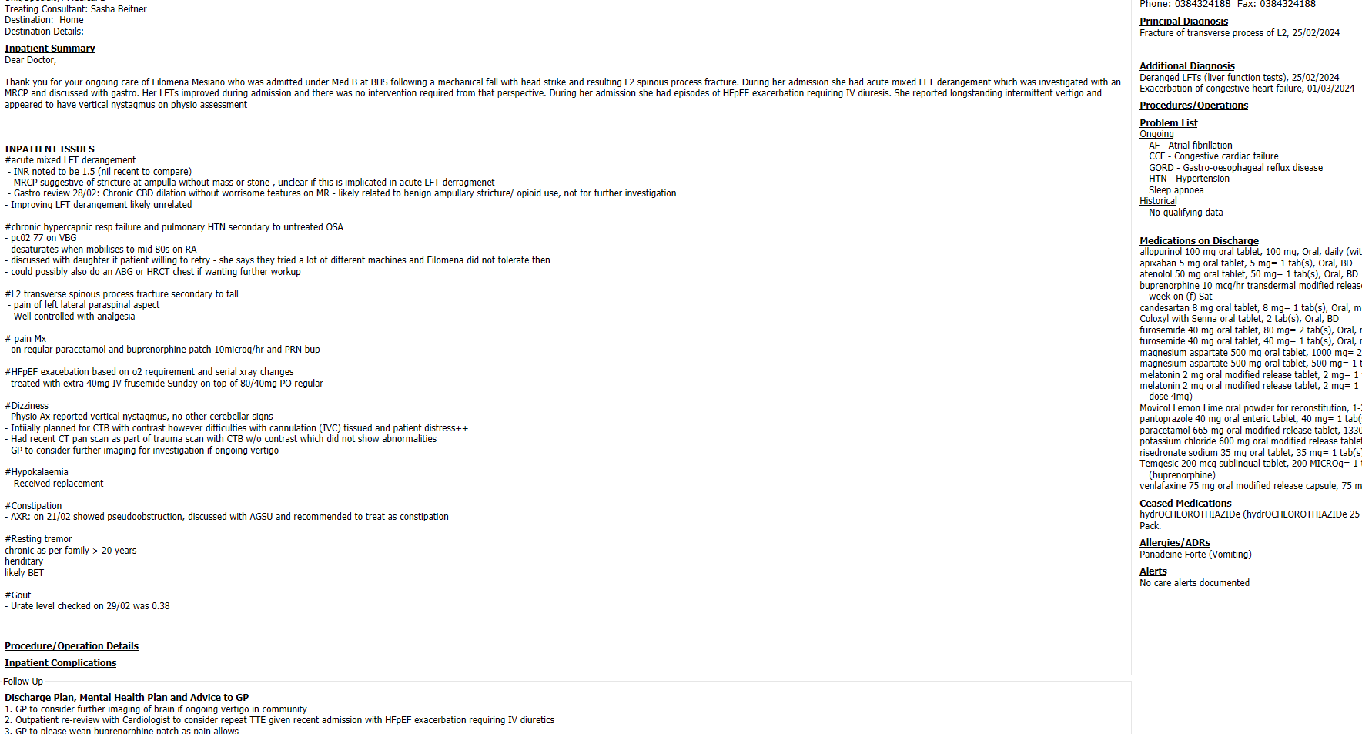
Discharge Summary - good
Great example, list of issue with PDx and Adx

Slide 9
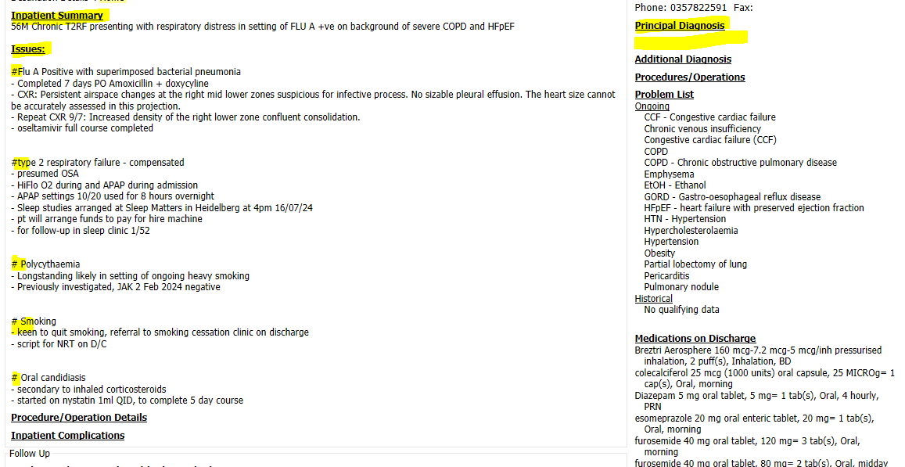
Discharge Summary – almost perfect
Great list of issues, missing PDx though ☹

Slide 10


Discharge Summary – Principal Diagnosis
When selecting a dx from the problem list, the options come with SNOMED codes.
There seems to be a code for everything, not standardized codes. We do not use these.
Do not select vague statements, please select a proper diagnosis.
Acceptable PDx:
Functional decline (usually in elderly)
Falls FI – unknown cause (or if likely due to another condition, eg postural hypotension, OA knee/hip)(multifactorial)
Chest pain FI (when cause of chest pain is unknown)
Unacceptable PDx:
Collection – select abscess, seroma, haematoma (likely or suspected)
Surgical follow-up – indication for surgery
Intervention/Surgical procedure
Blank
UR 2254421 dis 4/7/24
Surg 2

Slide 11
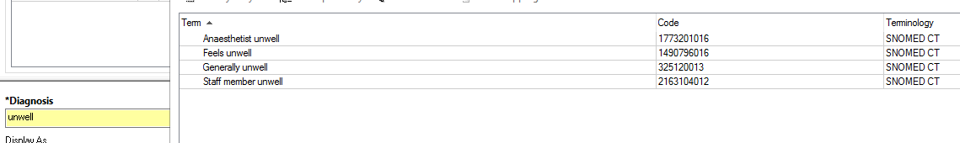
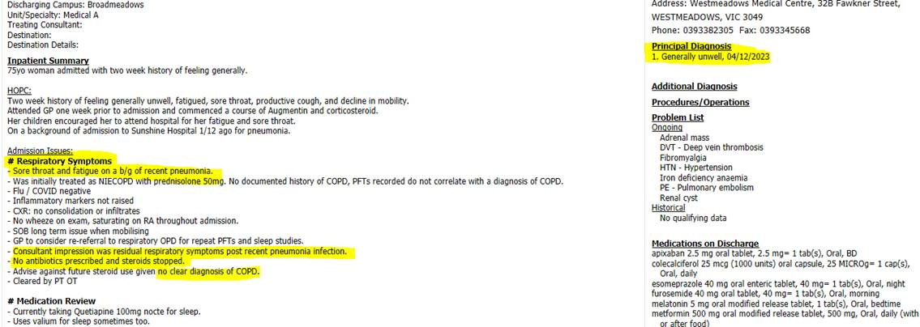
Discharge Summary – PDx options example

Slide 12
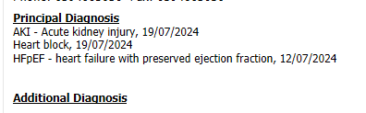
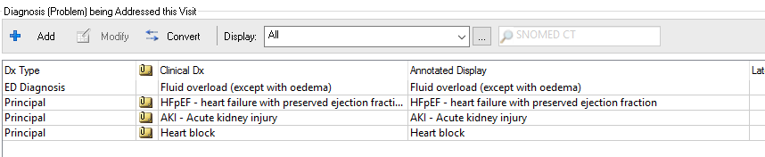
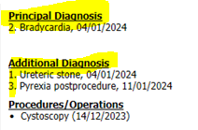
Discharge Summary – One Principal Diagnosis
If there is more than one, it alphabetizes.
Causes problems for clinical coders.
Affects DRG and NWAU.
Numbering diagnoses, also doesn’t make sense. Stop numbering.
Stick to entering one PDx and the others “Diagnoses”.

Slide 13
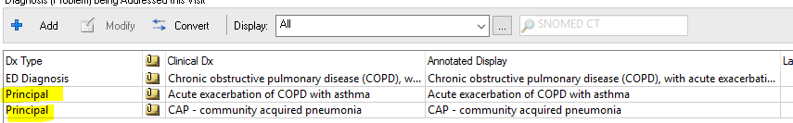
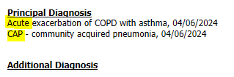
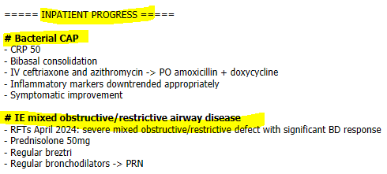
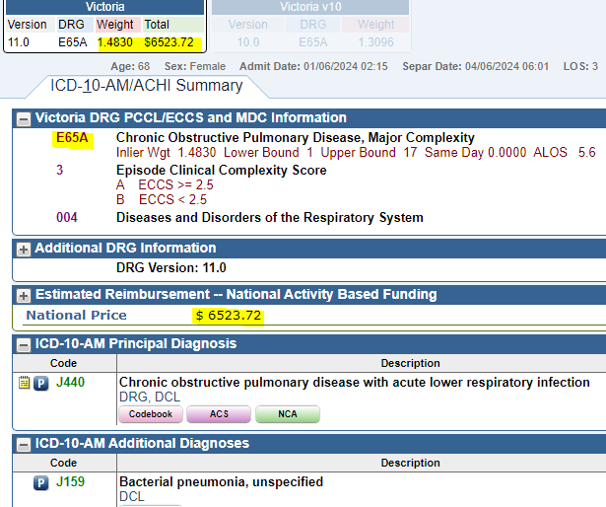
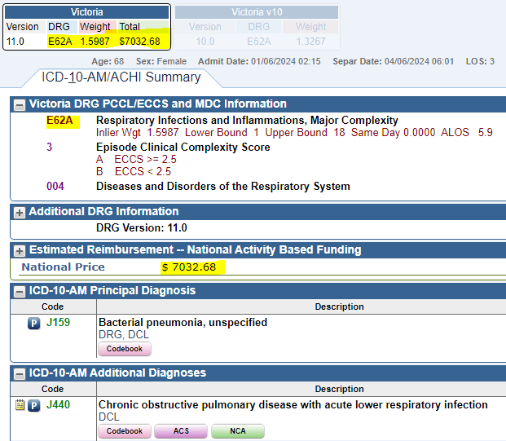
Discharge Summary – Principal Diagnosis PDx
Pneumonia first will always pay more than COPD

Slide 14
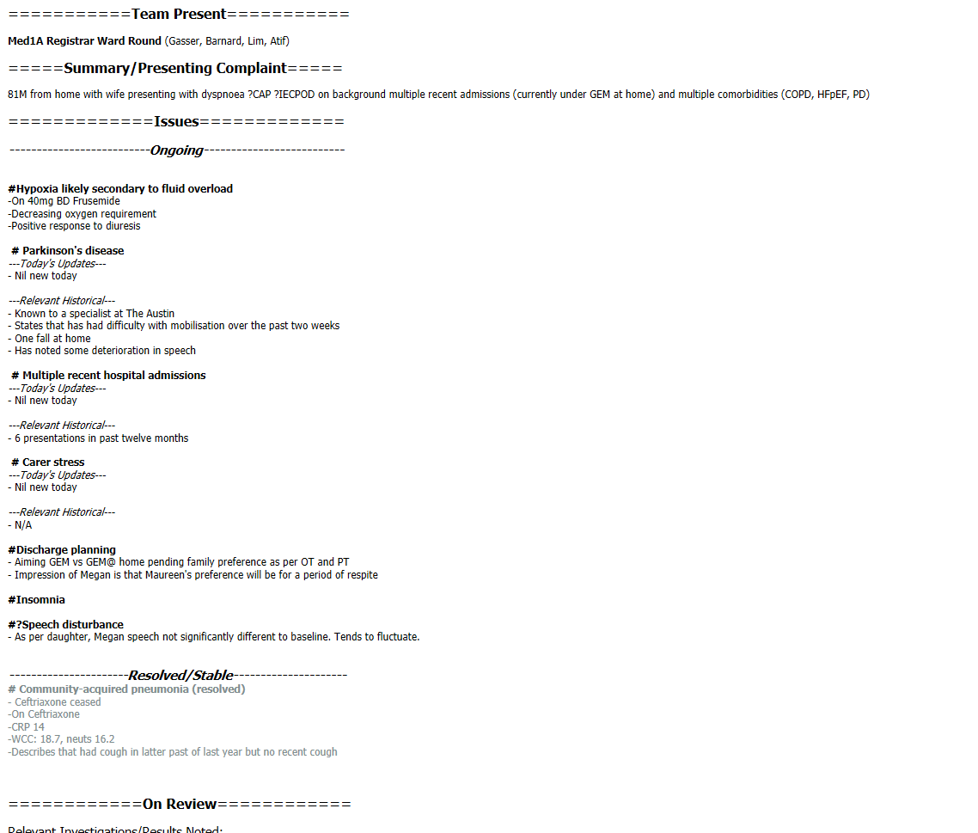
EMR - Progress notes
DO NOT copy+paste previous information.
Only add new information – today’s progress.
Acknowledge reason for admission.
List each issue and link it to management plan.
Rule out impressions – document this.
Document resolved and date if known.
Example March 2024 Med1A

Slide 15
Let’s code a record together

Slide 16
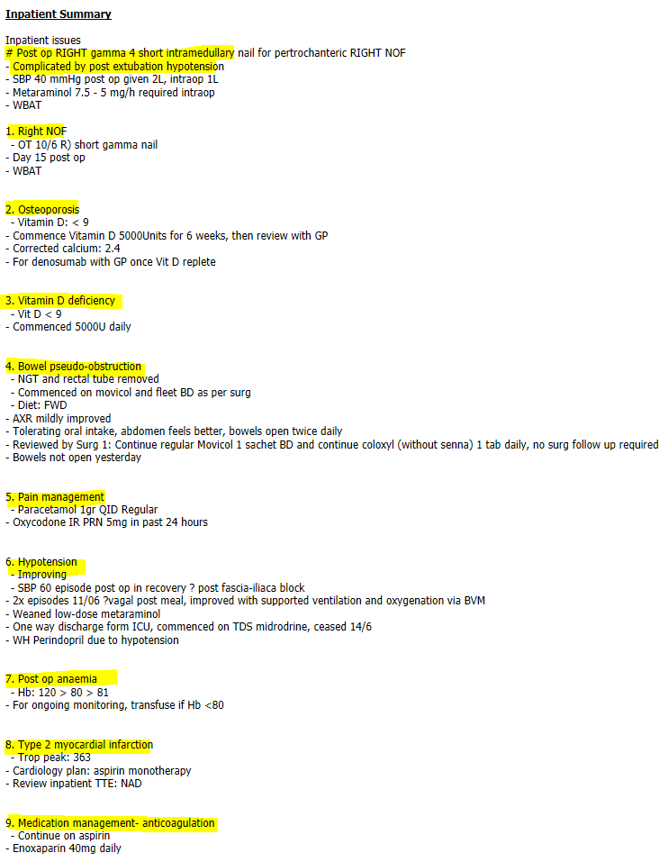
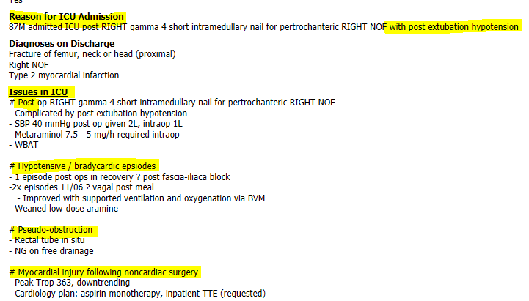
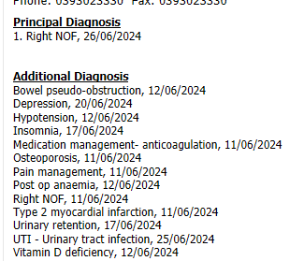

Coding tells the story
Patient presents via ED following a fall with fractured NOF for internal fixation.
Inpatient stay was complicated by post-extubation hypotension which occasioned patient to the ICU.
Other complications listed including 2 reportable HACs – AMI and UTI.
Notes:
Reason for admission to ICU – elective due to known asthma, obesity, OSA whatever, please document this.

Slide 17
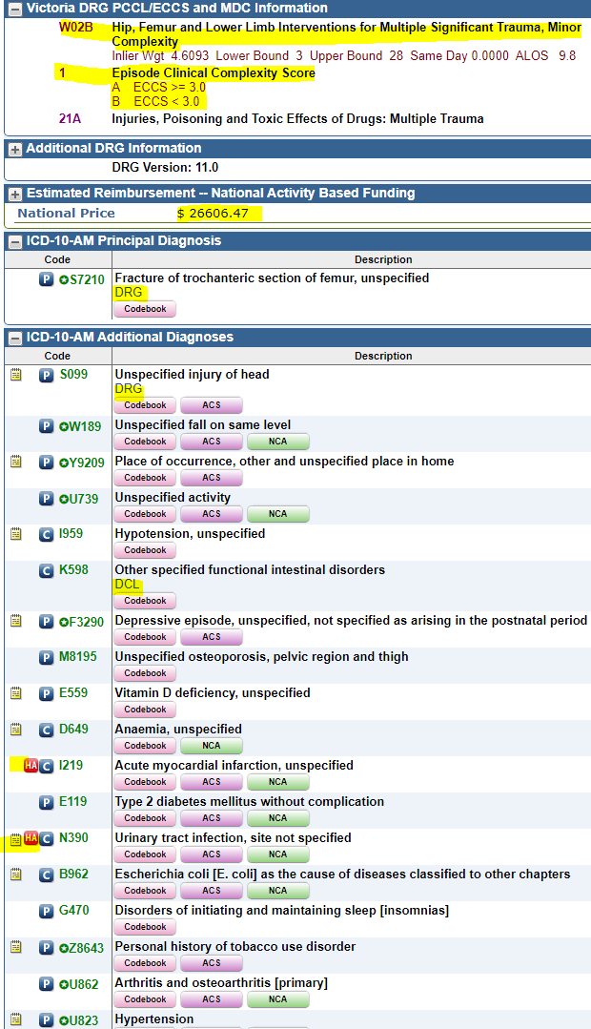
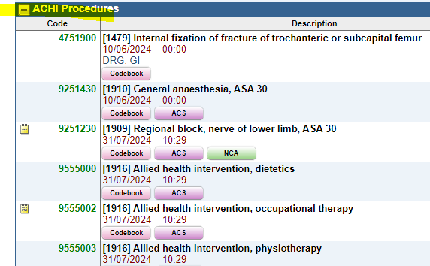
UR 0335294 dis 27/6/2024
LOS = 18
ALOS = 9.8
Could we have done better?
Principal diagnosis: Fracture NOF due to fall
Additional diagnoses: Depression, OP, Vit D deficiency, T2DM, insomnia, ex-smoker and chronic conditions (HT, OA)
Complications: (arose during encounter):
Hypotension
Pseudo-obstruction, anaemia
HACs – AMI, UTI
Interventions: Internal fixation # under GA and block, AH
DRG: W02B Hip, Femur and Lower Limb Interventions for Multiple Significant Trauma, Minor Complexity
DCL Diagnostic Complexity Level: values 0-4
ECCS Episode Clinical Complexity Score: A=4, B>=2.5, C <2.5

Slide 18
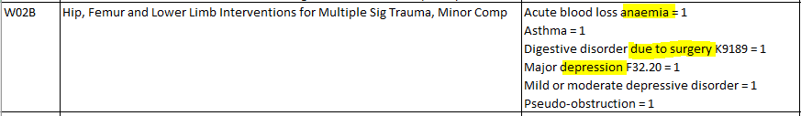
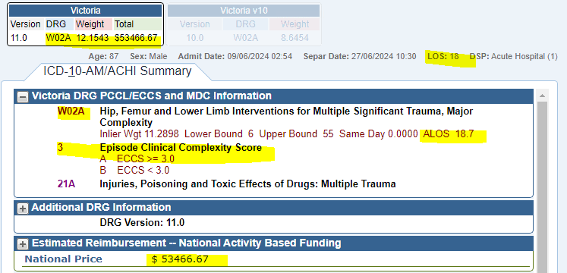
Optimising NWAU and DRG - specificity
NWAU Optimising Team:
CDI Team in real-time
Coding auditors retrospectively
Double our money!!
Optimised by:
Specifying anaemia as acute blood loss anaemia DCL = 1
Specifying depression as Mild Depressive Disorder DCL = 1 (or other specified)
Patient required NGT for pseudo-obstruction, if we could say secondary/due to surgery then we add and additional code K91.89 DCL = 1
We have now optimised NWAU!! Note the average LOS is 18.7 as is our patient’s LOS.

Slide 19
CDI Queries
Feedback

Slide 20
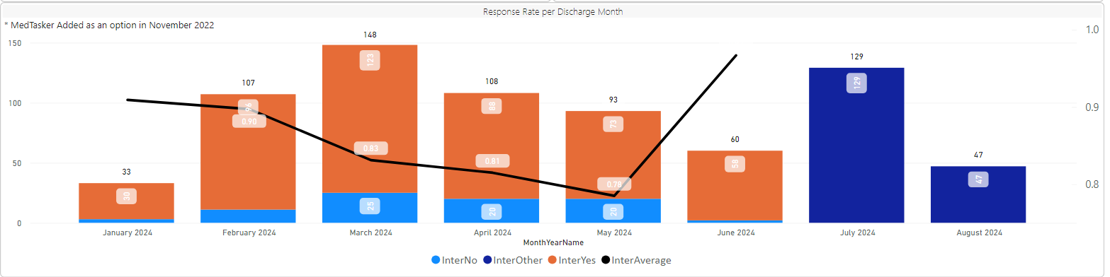
CDI Queries via Medtasker
Clinical Documentation Integrity (CDI) program established late 2017/2018.
Review the clinical documentation in real time and send queries to improve documentation gaps.
Ensure Clinical coders have accurate documentation to code from and ensure optimised reimbursement.
Drop in response rate from March – May – likely due to PDx queries.
Improved again in June 2024.
Comment in Medtasker to let us know where you have documented the response or when you have done it.
Please don’t leave blank. Important to action requests.
Feel free to ask questions via Medtasker or tell us that you disagree etc. Good communication ☺
Coffee cards to acknowledge good documenters!

Slide 21
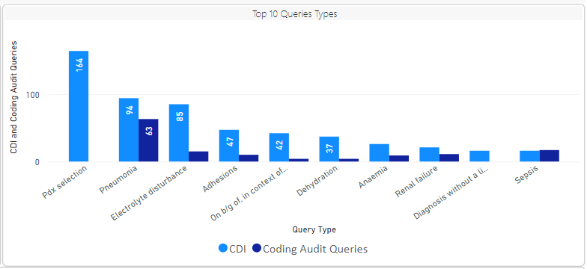
Frequently asked Query Types
Pdx – blank in EMR DCS
Pdx – advise what to place as Pdx
Pneumonia – bacterial
Electrolyte disturbances – Mg deficiency
Adhesions – were they divided
Adhesions – are they due to previous surgery
On b/g of – replace with “due to” or “2’ to” to make a causative link, aetiology
Dehydration – dry MM – IVT, pre-renal AKI etc
Dx without a link to plan – coders need this otherwise cannot be coded

Slide 22
CDI Queries not answered – consequences scenario 1
Hi Joe, I have a documentation query for you: 1. The admit progress note 6/5 has documented pt had Dry mucous membranes ++, increased skin turgor/low urine output and was started on IV fluids, which continued on the ward. Can you clarify if the pt was managed for dehydration as well? If so pls list as an additional issue on the d/c summary and link to the management. Thanks for your time CDS
EMR Checked for documentation of dehydration or volume depletion
Joe: "yes was just secondary to her gastro, i can change if needed"; CDS: "thanks that would be great"
A08.4 Viral gastro
$1,068.96
A08.4 Viral gastro
E86 Dehydration
$3,642.37
Picked up on audit report most of the time
Auditor sends a retro query (months later)
Await response from clinician before we make the change and optimise NWAU
CDI aims at getting it right the first time ☺

Slide 23
CDI Queries not answered – consequences scenario 2
Hi Joe, I have a documentation query for you: 1. The admit progress note 6/5 has documented pt had Dry mucous membranes ++, increased skin turgor/low urine output and was started on IV fluids, which continued on the ward. Can you clarify if the pt was managed for dehydration as well? If so pls list as an additional issue on the d/c summary and link to the management. Thanks for your time CDS
EMR Checked for documentation of dehydration or volume depletion and only found in Problem list as refresh of discharge summary not done
Joe: "yes was just secondary to her gastro, i can change if needed"; CDS: "thanks that would be great"
A08.4 Viral gastro
$1,068.96
A08.4 Viral gastro
E86 Dehydration
$3,642.37
Picked up during CDI reconciliation (sometimes can be picked up in real time)
CDI Coordinator performs “refresh” and makes coding changes.
NWAU is optimised, but poor clinical coder ends up with a DRG change (poor performer)

Slide 24
CDI Queries – response only in Medtasker scenario 3
Hi Emma, I have a documentation query for you. In the operation report it states there were omental adhesions onto the gallbladder. Can you please clarify (if possible) if, these were divided during the procedure? Thanks for your time
EMR checked for documentation of DOA.
Unfortunately, not in EMR, so cannot be coded and reflected in the data.
Emma: "Yep they were divided :)"
Clinical coders cannot abstract from Medtasker.
Sometimes the CDS has time to review the EMR after receiving a response in Medtasker and can provide further instructions.
Source of truth is in EMR.
Thank you Emma for responding in Medtasker though to let us know ☺

Slide 25
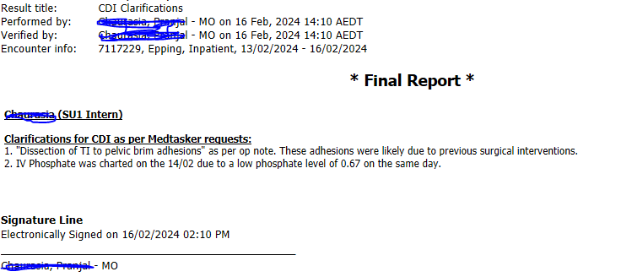
CDI Response in EMR example
UR 0567219 16/2/2024

Slide 26
Tips & Tricks

Slide 27


Clinical Documentation Tips
Interpret abnormal results – give it a diagnosis
Link the diagnosis to an intervention or plan
Link the intervention/plan to the diagnosis
Be specific: acute, chronic, bacterial, viral, severe
Use “due to” or “secondary to”, “2’ to”
Document “ruled out”
Present on Admission POA or Hospital Acquired Complication HAC

Slide 28
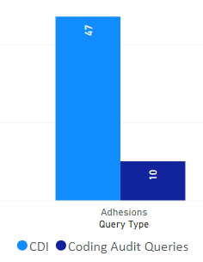
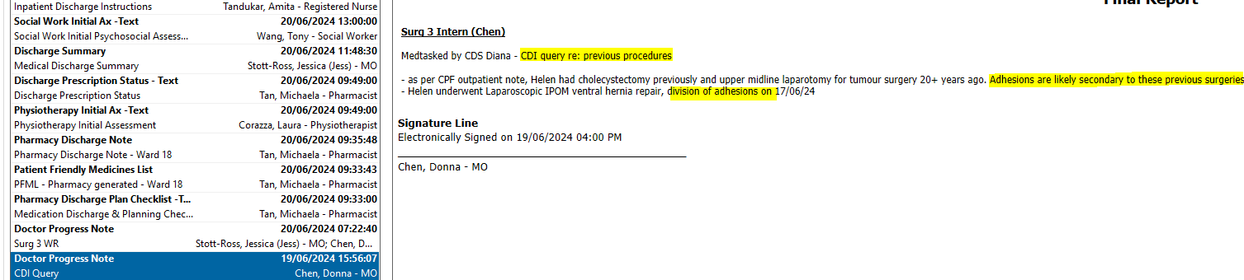
Adhesions
Shout out to all the surg interns who asked their seniors about adhesions due to previous surgery.
By adding in an extra code to show adhesions are due to previous surgery we receive and extra DCL
We have noticed a great improvement in documentation 😊
We increased NWAU or enriched the data.
Example 0124159 20/6/2024
Example of how it can be answered in notes.

Slide 29
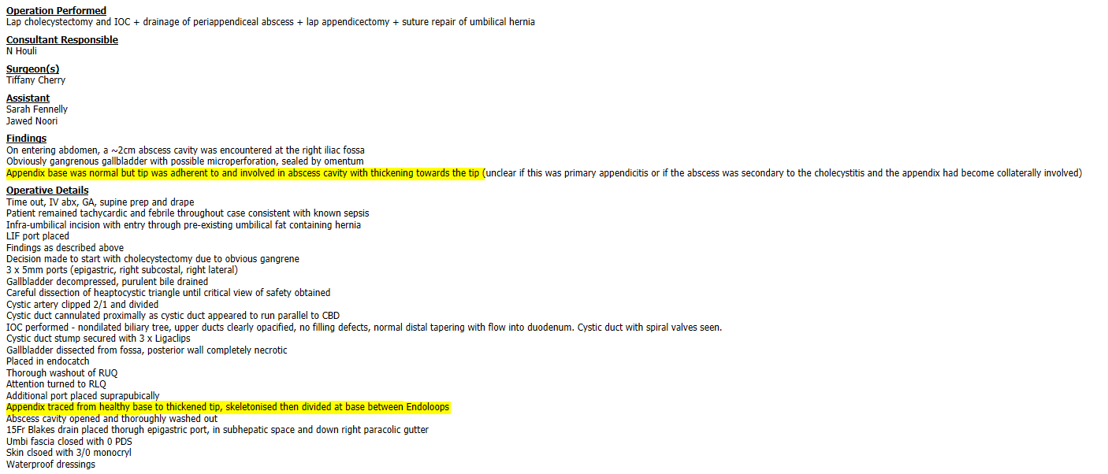
Division of Adhesions
Unclear to clinical coder, so please verify in EMR again.
Dr A: "Hey! Yes adhesiolysis was performed as per the op note”.
UR 9012285 dis date 12/6/2024

Slide 30
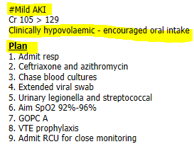
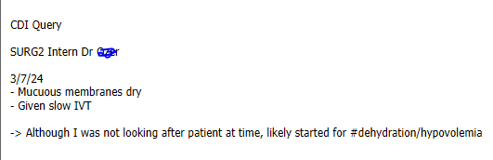
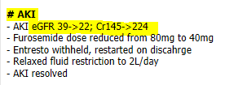

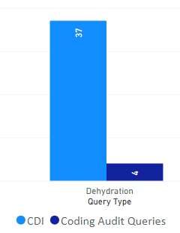
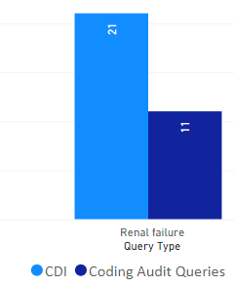


AKI and Dehydration
Often see “dry” or dehydration on admission assessment and never mentioned again in notes. Please list it as an issue again when receiving the patient on the ward.
Maintenance IVT or treatment for dehydration/pre-renal AKI.
Cannot code off results alone, like eGFR (see below)

Slide 31
Sepsis
Sepsis is defined as “life-threatening organ dysfunction caused by a dysregulated host response to infection”. Sepsis can be documented if present even in the absence of a positive blood culture result (bacteraemia)or fever.
Sepsis is likely to be diagnosed in ED, treated immediately, patient is stabilised then admitted to the ward to find the source.
It is then sometimes forgotten about in ward progress notes.
Important to document so that we can show the severity of condition – in data.
When Sepsis is present, please document it on the Discharge Summary and in progress notes.
Document the localised infection when known separately:
Sepsis with or secondary to (pneumonia, UTI, meningitis, cellulitis, cholecystitis/cholangitis, renal calculi, catheters, miscarriages, recent wounds, recent surgery, neutropaenia and those immunocompromised) OR
Sepsis of unknown source
Do not document:
Chest sepsis, Biliary sepsis, Urosepsis
Make it clear if “present on admission” or if “hospital acquired” so it can be reported as a true HAC.

Slide 32
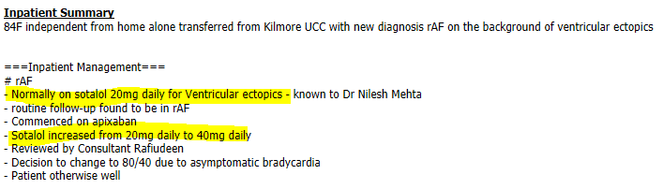

Change in medication
Excellent note about patient on Sotalol 20mg for ventricular ectopics.
Sotalol increased to 40mg.
Therefore ventricular ectopics can be coded and it carries a DCL ☺
Example 0193341 14/04/2024 CAHF

Slide 33

Stroke
Important Tips:
Document ischaemic (infarct) or haemorrhagic.
Document manifestations/effects of stroke and link to management plan, eg hemiplegia/L sided weakness, dysphagia, new urinary incontinence.
Document aetiology when known, eg AF.
UR 0015441 23/2/2024

Slide 34
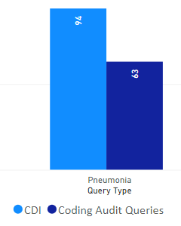
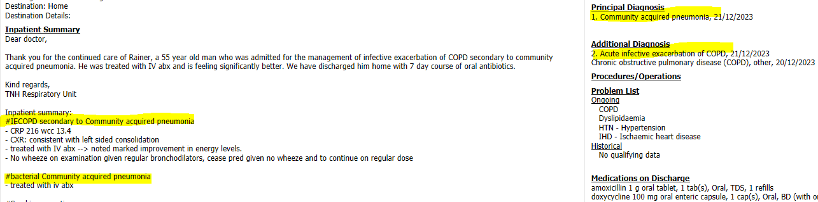
Pneumonia – further specificity
Pneumonia, CAP, HAP, LL pneumonia etc has DCL = 0 or 1
Bacterial or viral pneumonia has DCL=1 or 2
When sputum grows a bug and there are sensitivities, we can link that bug with pneumonia.
When no bug is identified and you treat patient with antibiotics, CRP, WCC etc, call it “bacterial”.

Slide 35
Pneumonia – further specificity
Hi Dr, I just have a documentation query for you. In the notes and d/c summary it states this pt was treated for CAP. To help with clinical coding specificity can you please confirm in the documentation if this was presumed viral or bacterial pneumonia? Thanks for your time!
CDI Query via Medtasker
"We started antis which means bacterial :)"
Needs to be documented in the notes. We wouldn’t be asking if we could make assumptions. Unfortunately in this case, it was coded as unspecified.
Flu A with superimposed bacterial pneumonia or infection
COVID with superimposed bacterial pneumonia
Does this mean both viral and bacterial pneumonia?

Slide 36
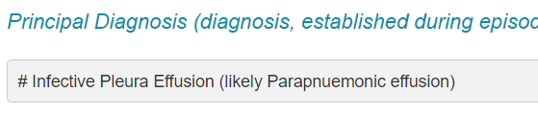
Parapneumonic effusion – further specificity
Parapneumonic effusion is a type of pleural effusion that arises as a result of a pneumonia, lung abscess or bronchiectasis.
Pt required antibiotics for the treatment of Infective Pleural Effusion, for coding purposes we require more specificity. Can you please specify if you were treating likely bacterial pneumonia? Thanks this will assist in accurate coding.
We need to capture that infective component, so we ask for pneumonia to assign 2 codes to describe parapneumonic effusion:
Pleural effusion J90
Bacterial pneumonia J15.9

Slide 37
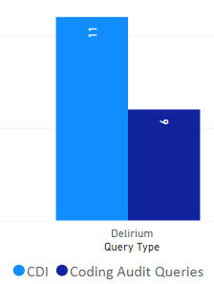
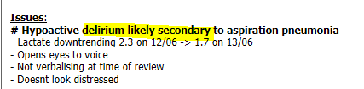

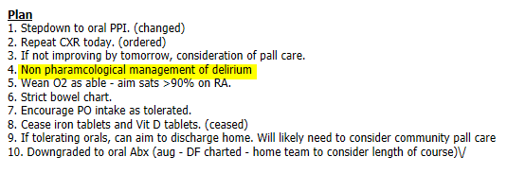
Delirium and Dementia
Enounter 7210456 20/06/2024
Document due to (medical condition)(infection) and dementia (specify type)
We can’t assume
Reason for 1:1 care or SIMON – can’t rely on nursing notes, must come form clinicians
Was it POA or HAC?

Slide 38

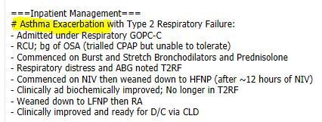
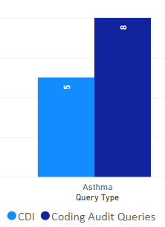
Acute severe asthma
Hi Doc, great notes from the team with thanks. 1. Any chance this patient was managed for acute severe asthma? ED note it as mod-severe asthma and patient required NIV/HFNP in RCU for acute T2RF. If yes, please update discharge summary or add a progress note. Thank you :)
Doc: "Thanks. I will amend the summary"
UR 0653063 25/3/2024
Was never documented as acute severe. Is this because clinician didn’t agree?
Must document “acute severe asthma”
Or status asthmaticus
Not severe asthma
Not acute asthma

Slide 39

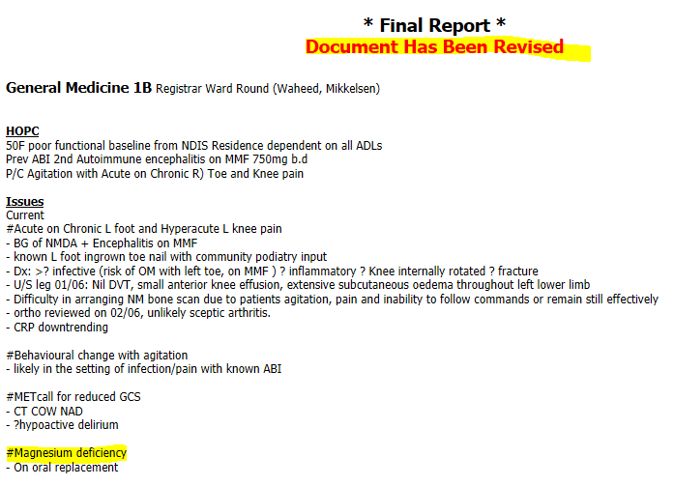

Electrolyte disturbances & nutritional deficiencies
Magnesium deficiency rather than hypomagnesaemia or low Mg2+
Vitamin deficiency, specified or unspecified has a DCL (thiamin)
Inadequate diet, imbalance of constituents of food intake

Slide 40


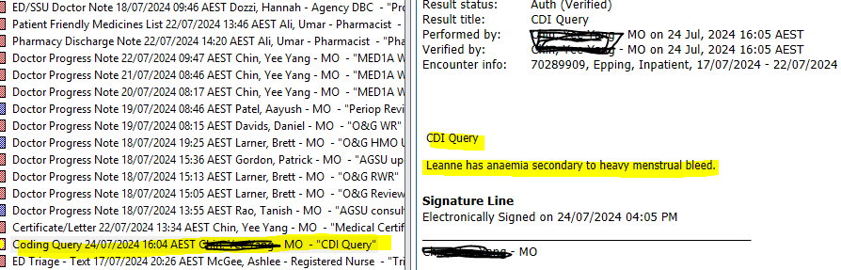
On the b/g of, in setting of, in context of

Slide 41
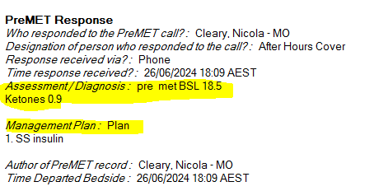
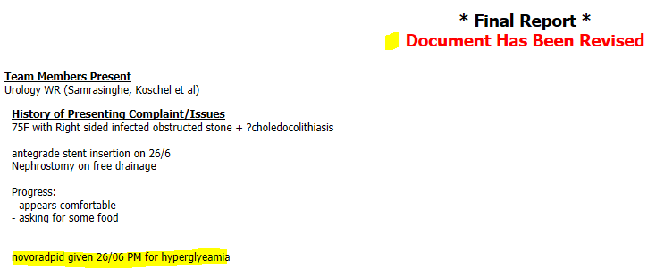
Ketosis and BSLs
UR 0087583 dis 28/6/2024
Ketosis = ketones > 0.6
We cannot code from levels – please call it ketosis
Elevated BSLs – document as hyperglycaemia

Slide 42
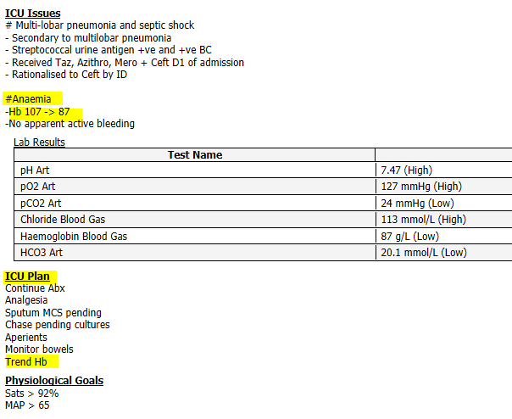
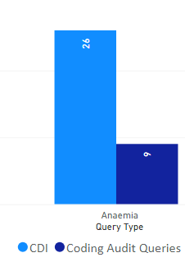

Anaemia
Good example of interpretation of results:
called it anaemia and plan to trend Hb
increased monitoring
Add specificity when you can, eg IDA, due to ABLA

Slide 43
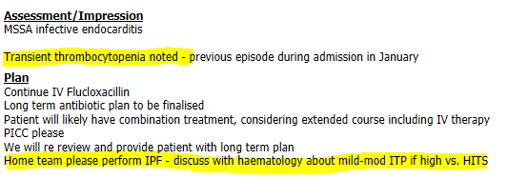
Consultations – written evidence
UR 2479353 20/6/24
Ensure the discussion with haematology is documented in EMR.

Slide 44
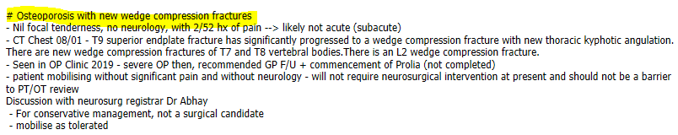
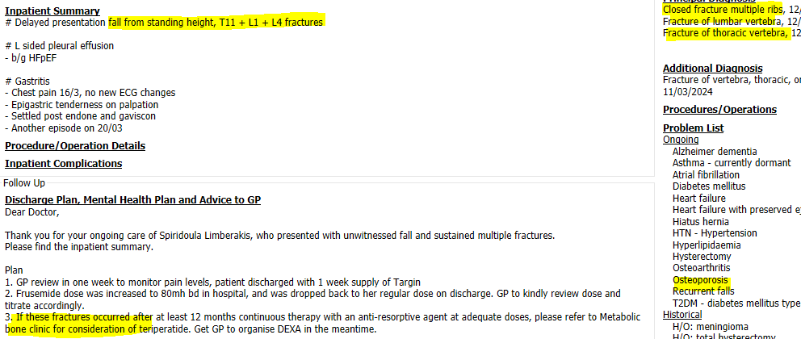
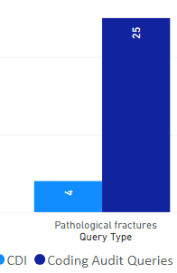
Osteoporotic fractures
UR 001542 18/1/2024
Elderly patients with OP
Present with #s following a fall
# secondary to OP and fall
Osteoporotic #s following fall

Slide 45



LFT derangement or abn LFTs
Ep 6169713 26/4/23
Can LFT derangement or abn LFTs be documented as:
Deranged LFTs secondary to … (fatty liver, other) = only acceptable if you are linking it to a liver condition
Liver dysfunction secondary to (medication)
Liver disorder or disease or failure

Slide 46


Reduced/low GCS
Not a condition/diagnosis:
↓GCS
GCS 3
Reduced/altered GCS
Must document decreased/reduced/loss consciousness or unconsciousness
Intubated for decreased consciousness GCS 3
Intubated for unconsciousness or coma
Drowsiness, Somnolence GCS 13-15
Clouded state = semi-coma, Stupor GCS 9-12
Coma GCS <= 8
Nontraumatic loss of consciousness LOC
Traumatic loss of consciousness LOC
GCS ≠ consciousness
UR 0120287 dis 10/5/2024
UR 2441414 dis 22/3/2024

Slide 47

Xerostomia
Aerophagia

Slide 48


Meet the Team
Mary Kouvas – CDI Coordinator – HIM (non-clinical)
30 years in Coding & Casemix
4 days, training of CDSs
mary.kouvas@nh.org.au
Diana Villalta – CDS – Dietician/Midwife (clinical)
5 days
diana.villalta@nh.org.au
Vacant CDS
= Less reviews

Slide 49

Competition
Diagnostic Complexity Level
What does DCL stand for?
Congratulations to recipients of CDI award for term 3!

Slide 50
Learning standards
This presentation addresses the following components of the Australian Curriculum Framework for Junior Doctors:
  Professionalism – professional standards; professional responsibility
  Communication – managing written information/electronic information and health records
This presentation is aligned with the following NSQHS Standards:
  Standard 1: Clinical Governance – Patient safety and quality systems – Healthcare records
  Standard 6: Communicating for Safety – Documentation of information

Slide 51

Thank you!
WE VALUE YOUR FEEDBACK!
Please complete the evaluation.
i-phone – just point camera
Android – use QR reader app
Or use this link: https://www.northerndoctors.org.au/education-session-feedback-form/

