Slide 1
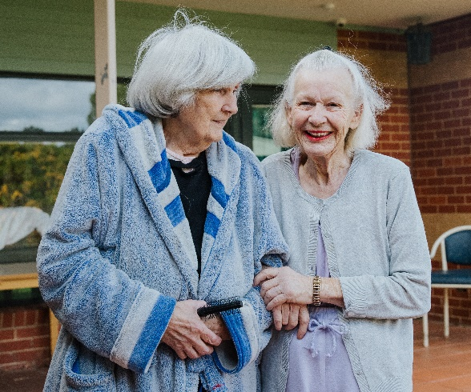

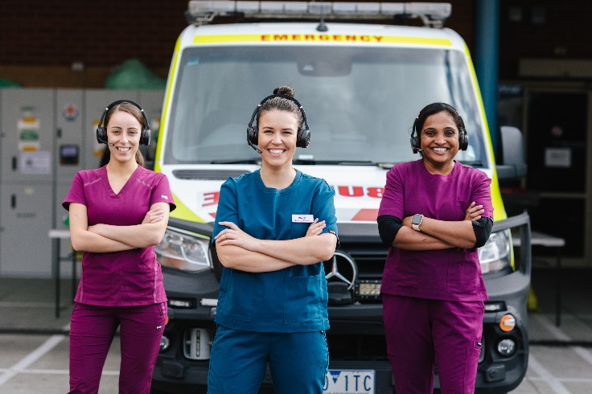
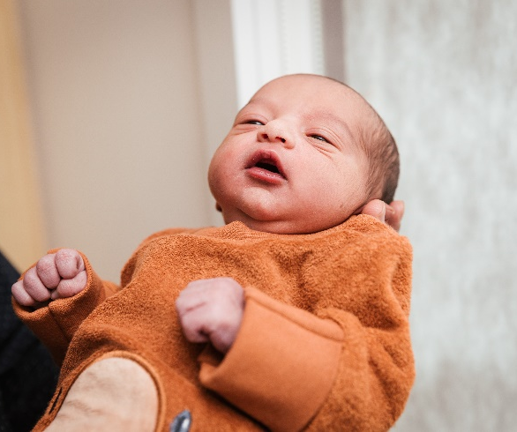
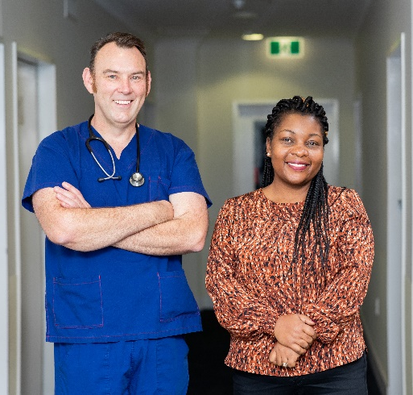


Inpatient Diabetes Management
Dr Michele Bardin
Tuesday 23rd July 2024

Slide 2
MEDTASKER/ PAGER
To avoid disruptions, please
Divert your Medtasker
Put pager on silence
This is a protected Intern Education session

Slide 3
Learning Objectives
Management of Acute Diabetes-related Problems in the Inpatient Setting – assess and manage hypoglycaemia and ketosis, Management of diabetes in peri-op setting
Diabetes-related Medication Safety – prescribes, calculates and administers key diabetes-related medications safely mindful of their therapeutic / risk profile

Slide 4
Learning Domains & Standards
This presentation addresses the following domains of the national AMC Framework for Prevocational (PGY1 and PGY2) Medical Training:
  Domain 1. Practitioner
  1. Prescribe therapies and other products including drugs, fluids, electrolytes, and blood products safely, effectively and economically
  2. Perform and document patient assessments, incorporating a problem-focused medical history with a relevant physical examination, and generate a valid differential diagnosis and/or summary of the patient’s health and other relevant issues
  Domain 2. Professional & Leader
  1. Take increasing responsibility for patient care, while recognising the limits of their expertise and involving other professionals as needed to contribute to patient care.
  2. Respect the roles and expertise of healthcare professionals, and learn and work collaboratively as a member of an inter-personal team.
  Domain 3. Health Advocate
  1. Incorporate disease prevention, relevant health promotion and health surveillance into interactions with individual patients, including screening for common diseases, chronic conditions, and discussions of healthcare behaviours with patients
  2. Apply whole-of-person care principles to clinical practice, including consideration of a patients physical, emotional, social, economic, cultural and spiritual needs and their geographical location, acknowledging that these factors can influence a patient’s description of symptoms, presentation of illness, healthcare behaviours and access to health services or resources.
  Domain 4. Scientist and Scholar
  Consolidate, expand and apply knowledge of the aetiology, pathology, clinical features, natural history and prognosis of common and important presentations in a variety of stages of life and settings.
  Access, critically appraise and apply evidence form the medical and scientific literature to clinical and professional practice.
This presentation is aligned with the following NSQHS Standards:
  Point 1
  Point 2

Slide 5
This presentation is aligned with the following NSQHS Standards:
  Medication safety standard (4.1)
  Clinicians use the safety and quality systems from the Clinical Governance Standard when:
  a. Implementing policies and procedures for medication management
  b. Managing risks associated with medication management
  c. Identifying training requirements for medication management
  Communicating for safety standards (6.3)
  Clinicians use organisational processes from the Partnering with Consumers Standard to effectively communicate with patients, carers and families during high-risk situations to:
  a. Actively involve patients in their own care
  b. Meet the patient’s information needs
  c. Share decision-making

Slide 6
Outline
Rationale for inpatient euglycaemia
Inpatient BGL targets and ketones
Ketosis management
Insulin types
Insulin titration
Management of hypoglycaemia
Perioperative management and cases

Slide 7
Northern Inpatient Diabetes Service (NIDS)
Guardians of safe glucose!
Wards 4 - 6, 14 – 21( except 17) are fitted with glucose monitors that feed into our database
We review anyone with BGL <4 or >15 or develop ketones
Aim is to maximise a patient’s time in the safe glucose range, and avoid hypoglycaemia

Slide 8
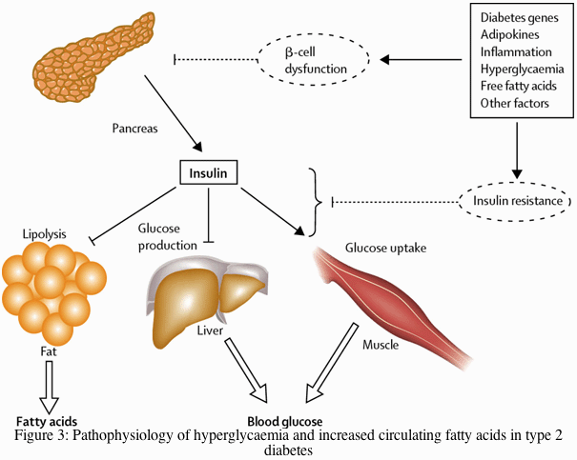
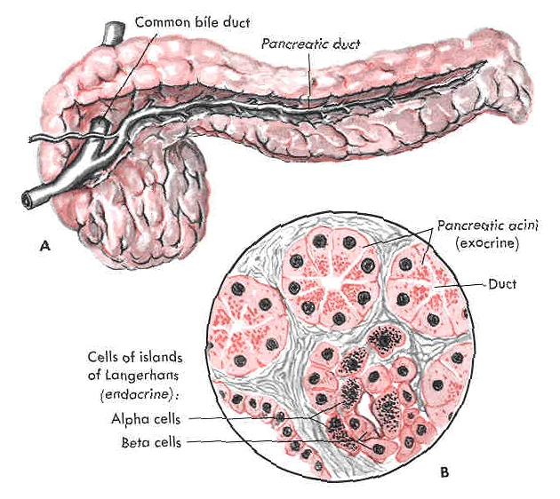
Role of Insulin
A hormone produced in the pancreas from beta cells that make up 1% of the pancreas
Involved in
Glucose homeostasis
Fat metabolism
Protein metabolism
Consider insulin to be a “storage "hormone
Normal BGL

Slide 9
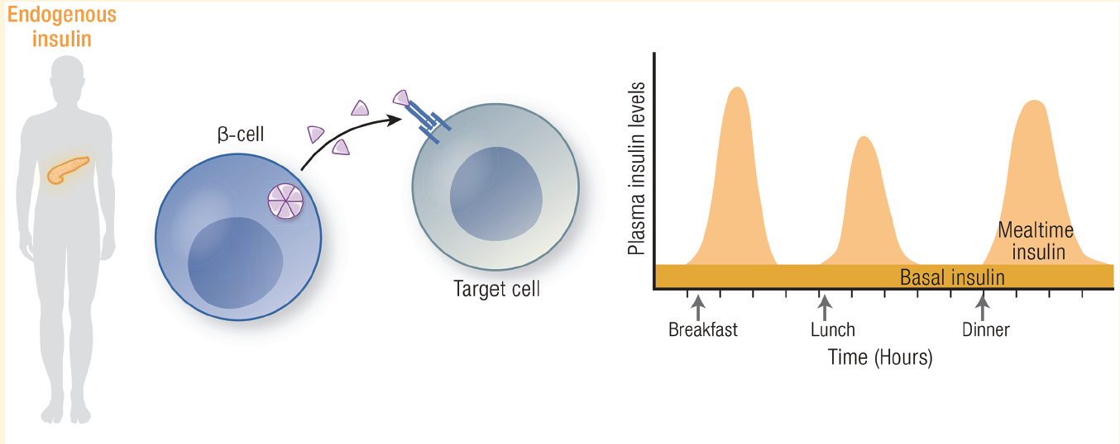
When your pancreas makes insulin
Hirsch et al. Endocrine Reviews 2020

Slide 10
Diabetes Mellitus
Ketones
Hyperglycaemia

Slide 11
When your pancreas has stopped making insulin…
Clues:
Duration of diabetes
Duration of insulin use
C-peptide <0.3
Islet Autoantibodies
History of DKA
T1D
LADA ( latent autoimmune diabetes in adults)
Burnt-out T2D
Pancreatectomy (could be partial or complete)
Pancreatic cancer
Immune-checkpoint inhibitors

Slide 12
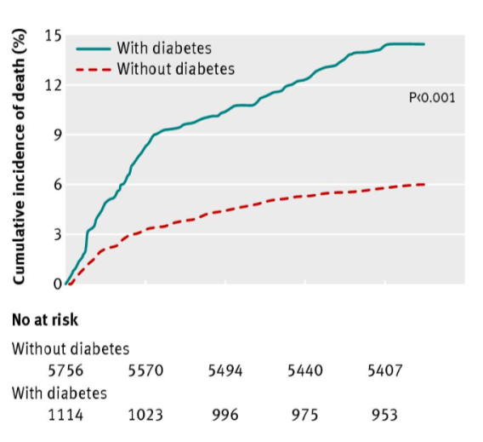
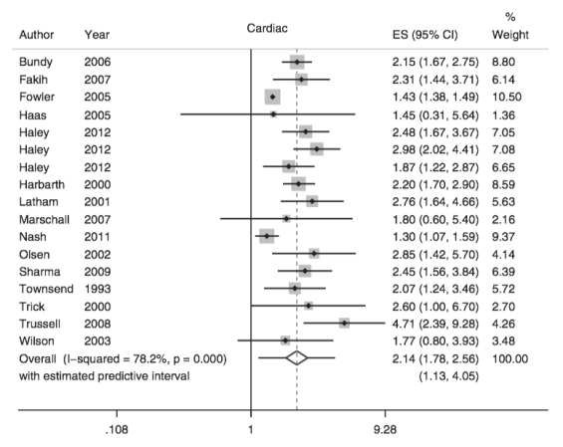

Diabetes is associated poor outcomes in hospital
Mortality adjusted HR: 1.9
Community-acquired pneumonia (n=6891)
Surgical wound infection OR: 1.56
Meta-analysis: 94 studies. >880,000 surgeries
Martin, et al., Infect. Control Hosp. Epidemiol., 2016
Lepper et al, BMJ 2012
Frisch, et al., Diabetes Care 2010

Slide 13
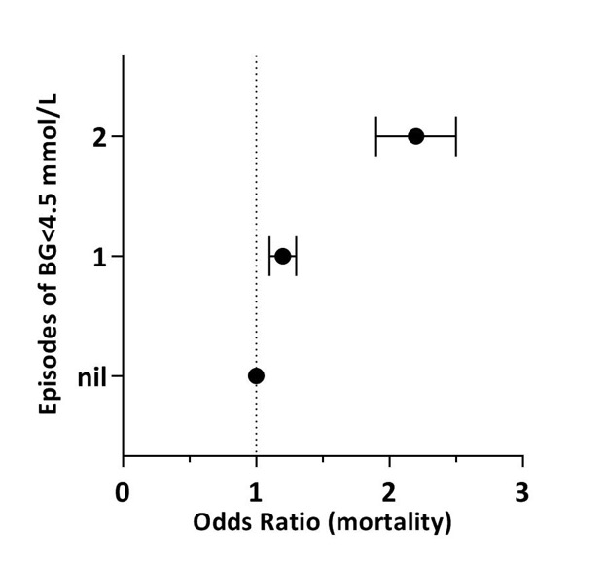
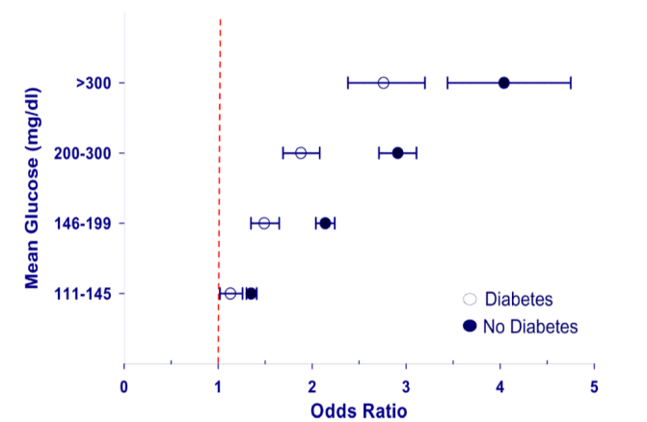
Acute hyperglycaemia & hypoglycaemia: independent predictors for mortality
Acute hyperglycaemia
Acute hypoglycaemia
Mean glucose mmol/L
>16.6
11.1-16.6
8.1-11.0
6.1-8.0
(mortality)
ICU admission (n = 249,040)
ICU admission (n=66184)
Falciglia et al, Crit Care Med 2009
Adapted from Bagshaw, et al, Crit Care 2009

Slide 14
Inpatient BGL targets
Avoid adverse glycaemia (<4 or >15 mmol/L)
General target: 5.0 – 10.0 mmol/L
Renal impairment: 5.0 – 12.0 mmol/L
Frail, multimorbid: 5.0 – 15.0 mmol/L
End of life care: Avoid symptomatic hyper or hypoglycaemia

Slide 15
Checking Ketones
Ketones are a waste product from fat metabolism
In the absence of insulin, glucose cannot get into the cells and it is not available for energy
The body starts to break-down fat > ketones > harmful to the body (acidotic)
If ketones are high, there is insufficient insulin
Ketone level > 0.6 non urgent review; >1.0 urgent review

Slide 16
Ketosis- Differentials
Diabetic ketosis
  Think VBG (acidosis, K+, glucose)
  Think SGLT2i (ends with -flozin) – euglycaemic ketosis
  Give hydration, glucose, insulin +/- K+ if needed
Starvation ketosis
  Ketones should not be much more than 2-3 mmol
  Give hydration and nutrition; insulin only if needed
Alcoholic ketosis
  Think thiamine (can cause lactic acidosis if not replaced)
  Give hydration, glucose / nutrition; insulin only if needed

Slide 17
What do you want to know?
58yo man
History of alcohol abuse but hasn’t drank for “years”
PHx: HTN, IHD, T2DM, OSA, GORD
Rx: Ramipril, metoprolol, aspirin, empagliflozin
Presents with vomiting, feeling unwell

Slide 18
What do you do?
Glucose 6.0, Ketones 4.0
VBG: pH 7.30
Initial plan:
Hydrate
Stop SGLT2i
Continue investigations for other differentials for ketosis
Discuss with endo re ongoing diabetes Mx!

Slide 19
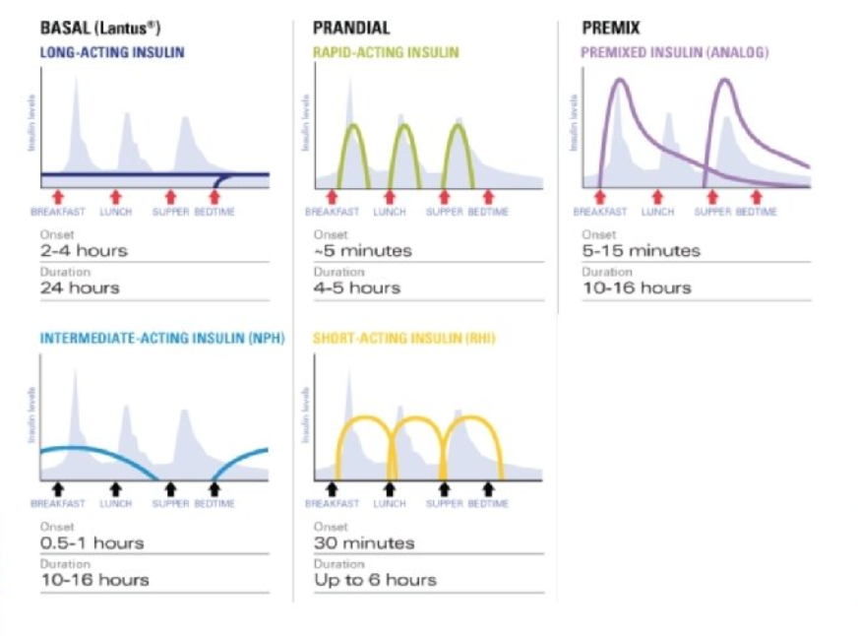
Types of Insulin
Fiasp
Novorapid
Humalog
Actrapid
Optisulin (~22-24hrs)
Levemir (~18hrs)
Toujeo (~36hrs)
Novomix 30/70
Humalog mix 25/75
Humalog mix 50/50
Protaphane
Ryzodeg 70/30
42 hrs!!
Nearly 2 days!!
Insulin profile
Time

Slide 20
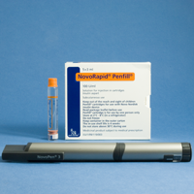
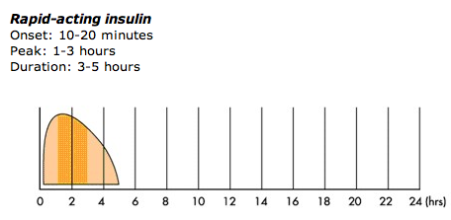
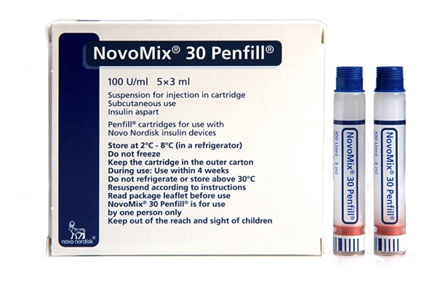
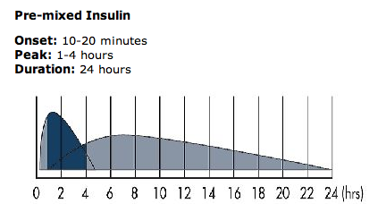
Novorapid ≠ Novomix 30

Slide 21
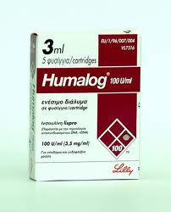
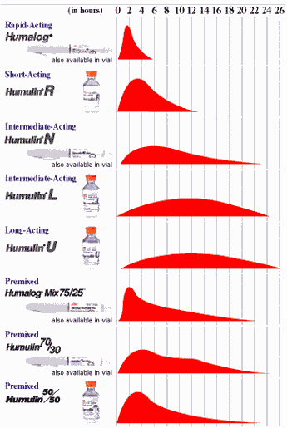
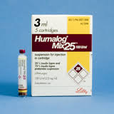
Humalog ≠ Humalog Mix 25

Slide 22
Insulin adjustment guidelines
(based on NY-presbyterian/weill cornell)
BG | Dose adjustment
< 2.8 | Decrease by 50%
2.8-4.0 | Decrease by 20%
4.1- 5.6 | Decrease by 10%
5.6-10.0 | No change
10.1-14.0 | Increase by 10%
>14.1 | Increase by 20% discuss with NIDS

Slide 23
Supplemental scale insulin
Previous insulin dose Patient body weight | Insulin sensitive < 30 units < 60 kg | Usual 30 – 80 units 60 – 90 kg | Insulin resistant > 80 units > 90 kg
BG > 20.0 | 6 units | 8 units | 10 units
BG 15.1 – 20.0 | 4 units | 6 units | 8 units
BG 12.1 – 15.0 | 3 units | 5 units | 7 units
BG 10.1 - 12.0 | 2 units | 4 units | 6 units
BG 4.0 – 10.0 | 0 units | 0 units | 0 units

Slide 24
Questions
How frequently can you give a rapid-acting insulin safely?
Why would you prescribe a pre-mix?
What are the advantages and disadvantages of an insulin like Ryzodeg 70/30?

Slide 25
What should I do?
Day | Over-night | Breakfast |  | Lunch |  | Dinner
 |  | Before | After | Before | After | Before | After
Mon |  | 7.6 |  | 11.2 |  | 19.8 | 22.1
Tues | 12.3 | 7.1 |  | 9.8 |  | 17.9 | 16.5
Wed |  | 8.4 |  | 10.0 |  | 22.3 | 18.9
Medications:
Metformin 1g bd
Optisulin 36 units nocte
Novorapid 10 units with breakfast, 8 units with lunch, 12 units with dinner
Increase Metformin
Increase optisulin
Increase Novorapid with breakfast
Increase Novorapid with lunch
Increase Novorapid with dinner
ALWAYS CHECK IF CORRECTIONAL “SUPPLEMENTAL”” INSULIN OR STAT DOSES HAVE BEEN GIVEN IN ADDITION TO THE REGULAR CHARTED INSULIN

Slide 26
What should I do?
Day | Over-night | Breakfast |  | Lunch |  | Dinner
 |  | Before | After | Before | After | Before | After
Mon |  | 17.3 |  | 11.2 |  | 8.5 | 11.3
Tues |  | 18.1 |  | 9.8 |  | 7.9 | 12.2
Wed |  | 15.3 |  | 10.0 |  | 11.3 | 13.9
Medications:
Metformin 1g bd
Optisulin 36 units nocte
Novorapid 10 units with breakfast, 8 units with lunch, 12 units with dinner
Increase Metformin
Increase optisulin
Increase Novorapid with breakfast
Increase Novorapid with lunch
Increase Novorapid with dinner

Slide 27
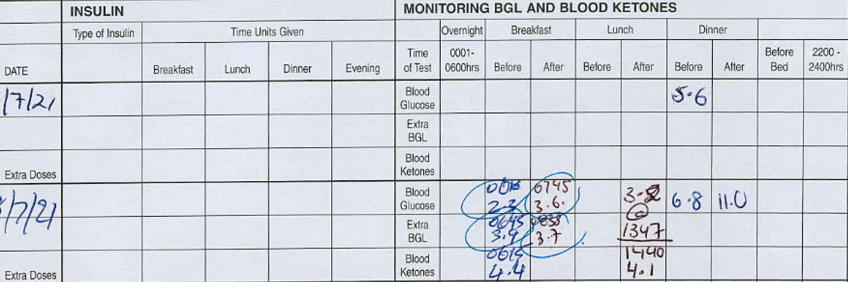
Hypoglycaemia
70F admitted with chemotherapy induced diarrhea

Slide 28
Acute management
If able to eat:
Give 15 g of fast acting CHO ( 6 jellybeans, ½ can soda, 1/2 glass fruit juice or 3 tsp of sugar/honey)
Recheck in 15 minutes
If BGL is less than 4, repeat step 1.
If BGL >4, eat a snack with longer acting carbohydrate.
If unable to take oral intake:
25-50mL of 50% dextrose IV
OR
2. 1mg glucagon IV/SC/IM

Slide 29

What next…?
A. Continue ward round
B. Remember to review the BGLs tomorrow
C. Stop their regular insulin / diabetes meds
D. Go and get a coffee
E. None of the above

Slide 30
PREVENTION is better than cure!!
How can we prevent the hypo from happening again?
What should you check? (FIGSS)
  Food intake / reverse food intake
  Insulin – timing, dose (nb check the supplemental insulin and stop or alter to more gentle correction)
  Gliclazide/Glibenclamide/Glimepiride
  Sepsis / Critically ill
  Steroid withdrawn

Slide 31
What should I do?
F: Address food intake if this is an issue
I: Reduce insulin by ~20% if hypo <4,
by ~10% if BGL 4-5
G: Halve dose of gliclazide or consider stopping altogether if already on insulin / other diabetes meds
S: Address sepsis / underlying illness
S: Have a steroid weaning plan

Slide 32
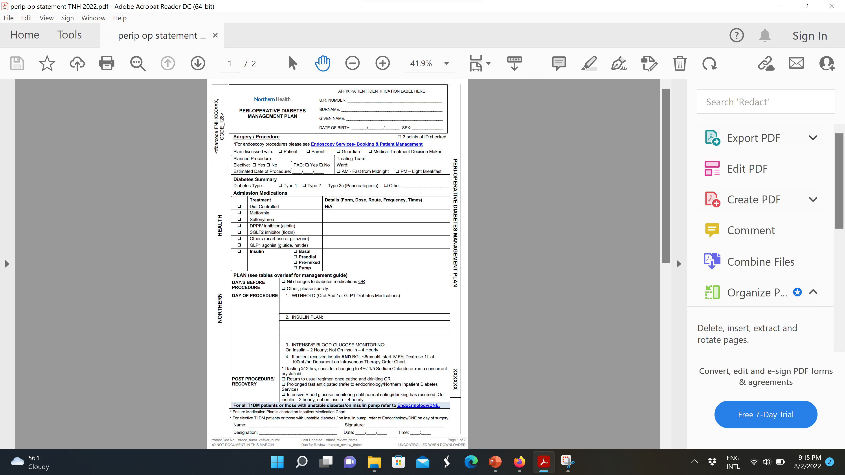
PERI OP Diabetes management -
PROMPT

Slide 33
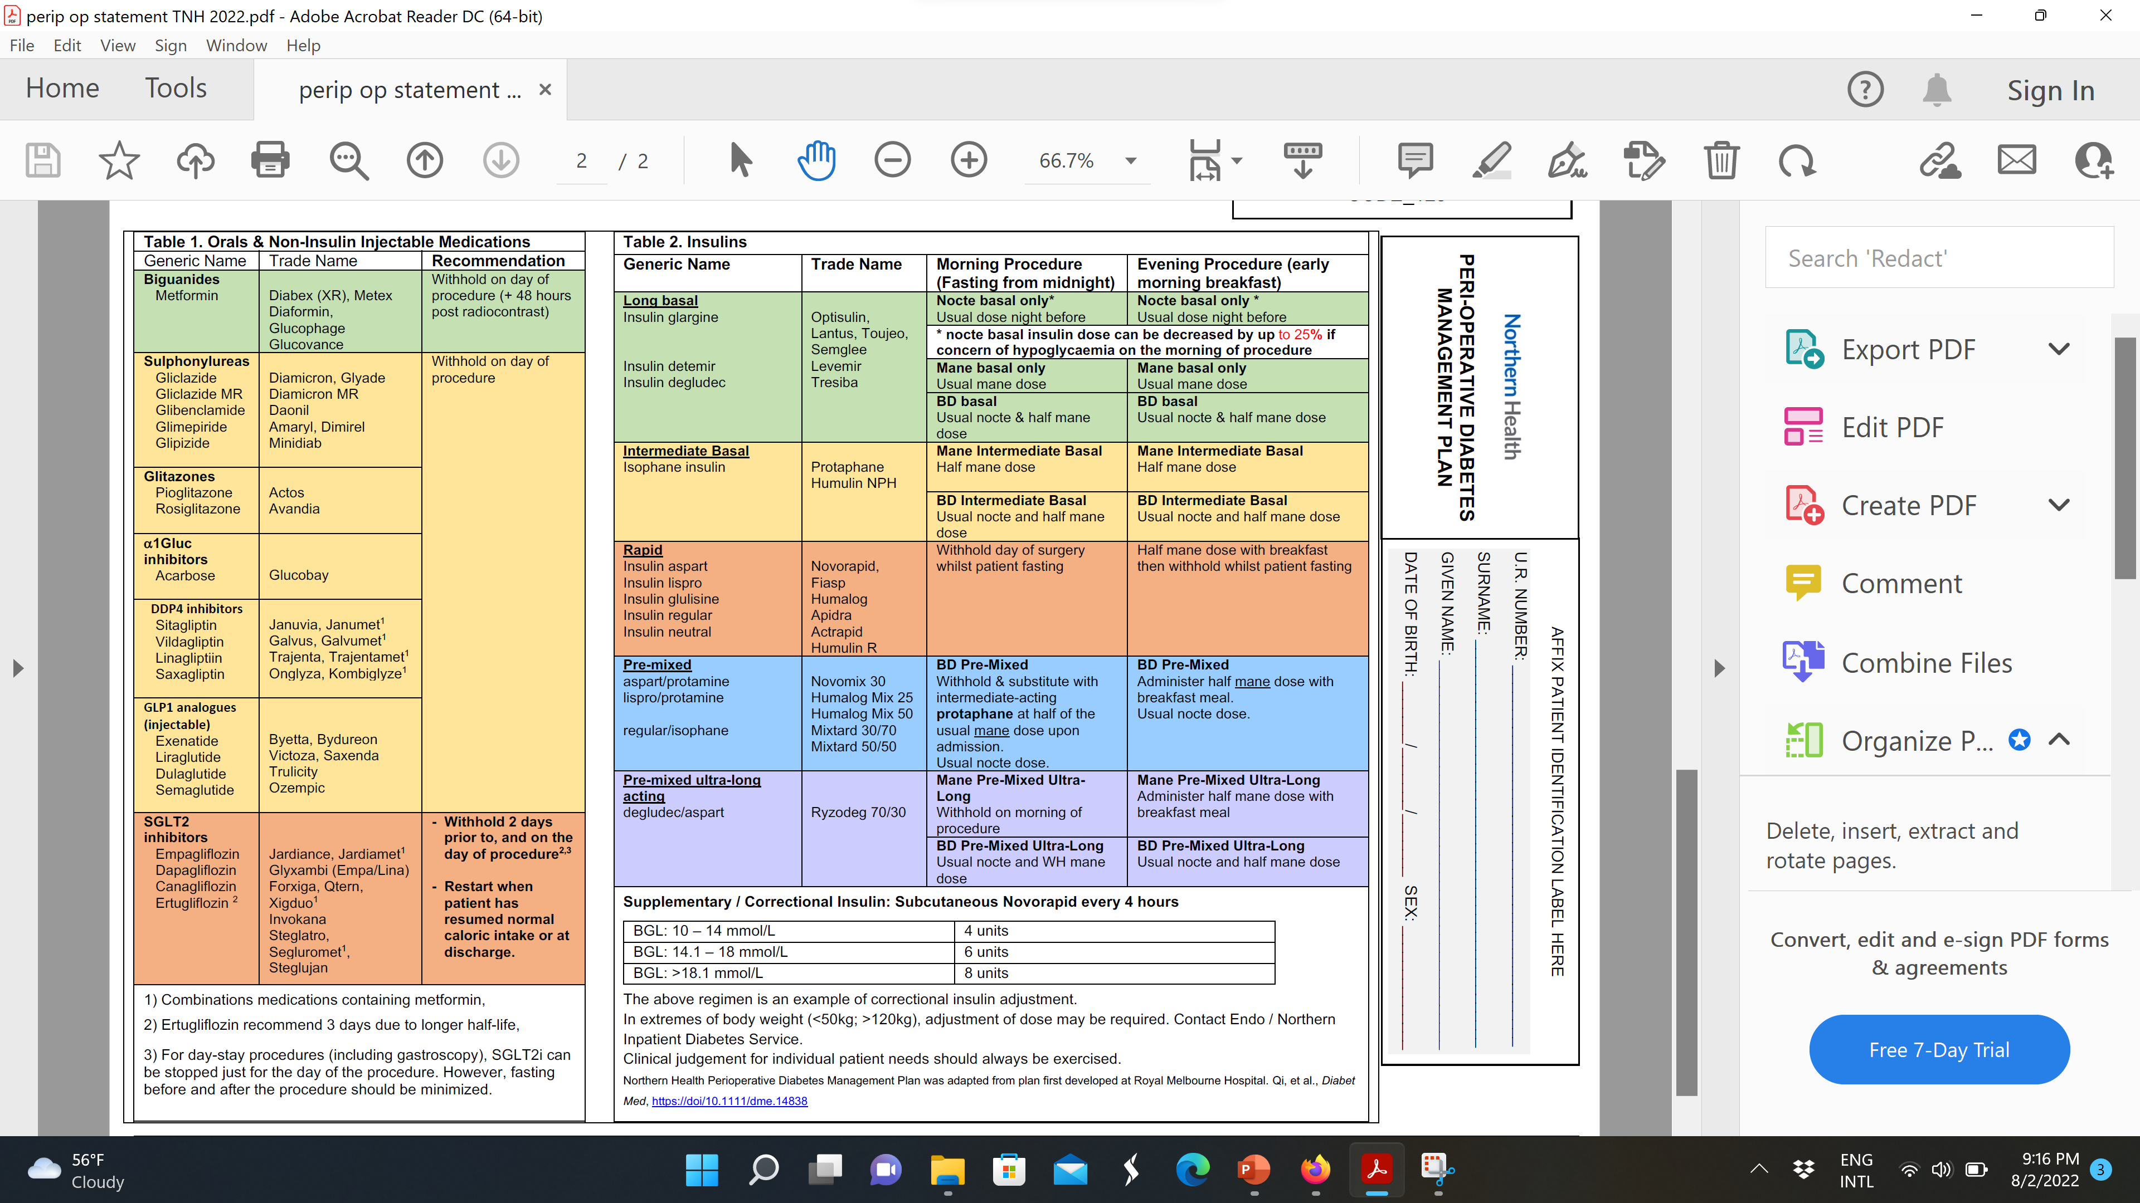

Slide 34
Key Pre-Op Rules
Clues:
Duration of diabetes
Duration of insulin use
C-peptide <0.3
Islet Autoantibodies
History of DKA
Don’t give rapid-acting / pre-mix insulin without food
  Exception: rapid-acting insulin can be given cautiously to manage v. high BGL (>10) while fasting every 4 hours
Give less (50%) rapid-acting / pre-mix insulin if eating a “light meal”
Never withhold insulin completely if the person doesn’t make any!
Withhold oral medication day of procedure [EXCEPT SGLT2i(“flozin”) – 2 days before and day of procedure]
  Resume if eating and drinking normally or 2 days after for SGLT2i

Slide 35
Other Challenges
Disrupted food intake
  Fasting for theatre… (e.g. Day 2 waiting for ‘emergency’ list…)
  Nausea
  Post-surgical ileus
Supplemental / alternative feeding
  Nutritional supplements
  NGT
  TPN
Altered activity levels
Patients losing autonomy
Surgical teams are in theatre

Slide 36
Feeds and Supplements
NG feeds result in significantly increased insulin requirements
Timing of the feeds is important:
  Continuous vs. Bolus vs Overnight
Interruption to feeds whilst on insulin can cause hypoglycaemia
  Change in feeds = Change in insulin doses
Oral supplementation can also cause hyperglycaemia that is difficult to predict
NIDS/ Endocrine team is always happy to know and help with any patients on feeds with diabetes

Slide 37
Case 1
60 F
For elective TAH
first on am list -FFM
Obese
T2DM dx 5 years ago
MF 1g mane
Gliclazide 120mg daily
Empagliflozin 25mg daily
How would you manage?
Notes:
TAH = total abdo hysterectomy

Slide 38
Case 1
Plan:
Withhold empagliflozin 2 days prior and cease until eating and drinking well post op
Withold metformin and gliclazide day of procedure
Check BGL 4 hourly
Chart very gentle sliding scale 4 hourly
60 F
For elective TAH
first on am list -FFM
Obese
T2DM dx 5 years ago
MF 1g mane
Gliclazide 120mg daily
Empagliflozin 25mg daily
How would you manage?
BGL (4 hourly) | Novorapid
BG > 20.0 | 6 units
BG 15.1 – 20.0 | 4 units
BG 12.1 – 15.0 | 3 units
BG 10.1 - 12.0 | 2 units
BG 4.0 – 10.0 | 0 units

Slide 39
Case 2
Novomix 30/70 : 50 units
Day | Over-night | Breakfast |  | Lunch |  | Dinner
 |  | Before | After | Before | After | Before | After
Mon ( FFM) |  | 17.3 |  | 12.0 |  | 8.5 | 14.0
Tues ( surgery) | 10.3 | 8.5
65M
T2DM for 20 years.
Novomix 30/70:
50 units breakfast
50 units dinner
Metformin 500g daily
Linagliptin 5mg daily
FFM for appendectomy
Questions:
How much and what insulin do you give Tuesday am?
Would you give the oral medications?
How often do you check BGLs?

Slide 40
Case 2
AM list- FFM PM list- FFBF
65F
T2DM for 18 years.
Novomix 30/70:
50 units breakfast
50 units dinner
Metformin 500g daily
Linagliptin 5mg daily
FFM for appendicitis, septic
Plan:
  1. Give 20 units protaphane tues am (⅓ to ½ of usual novomix insulin dose)
  2. Metformin should have been withheld since admission – septic! Linagliptin day of surgery.
  2. Check BGL 2 hourly
  3. Chart 5% dextrose 100ml/hr if BGL < 6 mmol/L and cease if > 10 mmol/L
  4. Chart supplemental insulin 4 hourly from BGL > 10 mmol/L

Slide 41
Case 3
Fasting from midnight Thursday for knee surgery Friday AM
52 F
‘’T2DM’’ (Dx 20 years)
Optisulin 40 units nocte
NR 12 units tds
Day | Over-night | Breakfast |  | Lunch |  | Dinner
 |  | pre | post | pre | post | pre | post
Wed |  | 5.5 |  | 12.0 |  | 6.0 | 8.0
Thursday FFM | 4.0 | 7.0 |  | 9.0 |  | 12.0
Questions?
1. What other information may be useful?
2. How would you manage?

Slide 42
Case 3
FFM Thursday night for knee surgery Friday AM
52 F
‘’T2DM’’ (Dx 20 years)
Optisulin 40 units nocte
NR 12 units tds
Day | Over-night | Breakfast |  | Lunch |  | Dinner
 |  | pre | post | pre | post | pre | post
Wed |  | 5.5 |  | 12.0 |  | 6.0 | 8.0
Thursday FFM | 4.0 | 7.0 |  | 9.0 |  | 12.0
Plan:
Consider reducing optisulin by 10% given hypoglycaemia night prior –ie given 36 units optisulin Thursday nocte
DO NOT WITHOLD optisulin
3. Withold regular NR Friday am and until eating post op,
4. Check BGL 2 hourly , Chart supplemental insulin 4 hourly from BGL > 10 mmol/L
5. Chart 5% dextrose 100ml/hr if BGL < 6 mmol/L and cease if > 10 mmol/L
Notes:
Was hypo overnight treated? ? Eating overnight, and corrective NR scale

Slide 43
Takeaway message
Don’t give pre-mixed / rapid-acting insulin when fasting
  Protaphane is a good option to tide someone over for 12 hours
  Look at the guidelines or ring NIDS if unsure – ring early!!
  Good glycaemic control = better surgical outcome!
Sliding scale to be charted appropriately
  TDS if eating
  If fasting: Q4H and checking BGLs Q2H to prevent hypoglycaemia
    Chart a pre-emptive dextrose infusion if BGL ≤6 with orders to stop if BGL > 10

Slide 44
Key points from today’s presentation
Never withhold insulin in someone who isn’t making insulin!
Hypoglycaemia should be treated and prevented!! – think FIGSS
Do not ignore ketosis (Greater than 1.0, something should be done!!)
Insulin titration
      Identify the origin of the problem, adjust by 10-20%
  Ryzodeg has a very very long half life which means the effect of your changes will only be fully seen in ~3 days
Call for help!
Send an HbA1c if they have diabetes and if ≥9%, call us!
If in doubt, call the Northern Inpatient Diabetes (NIDS) Team / Endo Reg!

Slide 45
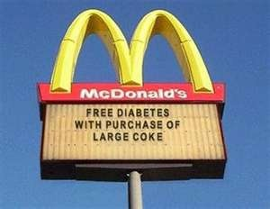
Questions?
Notes:
Insert QR code

Slide 46
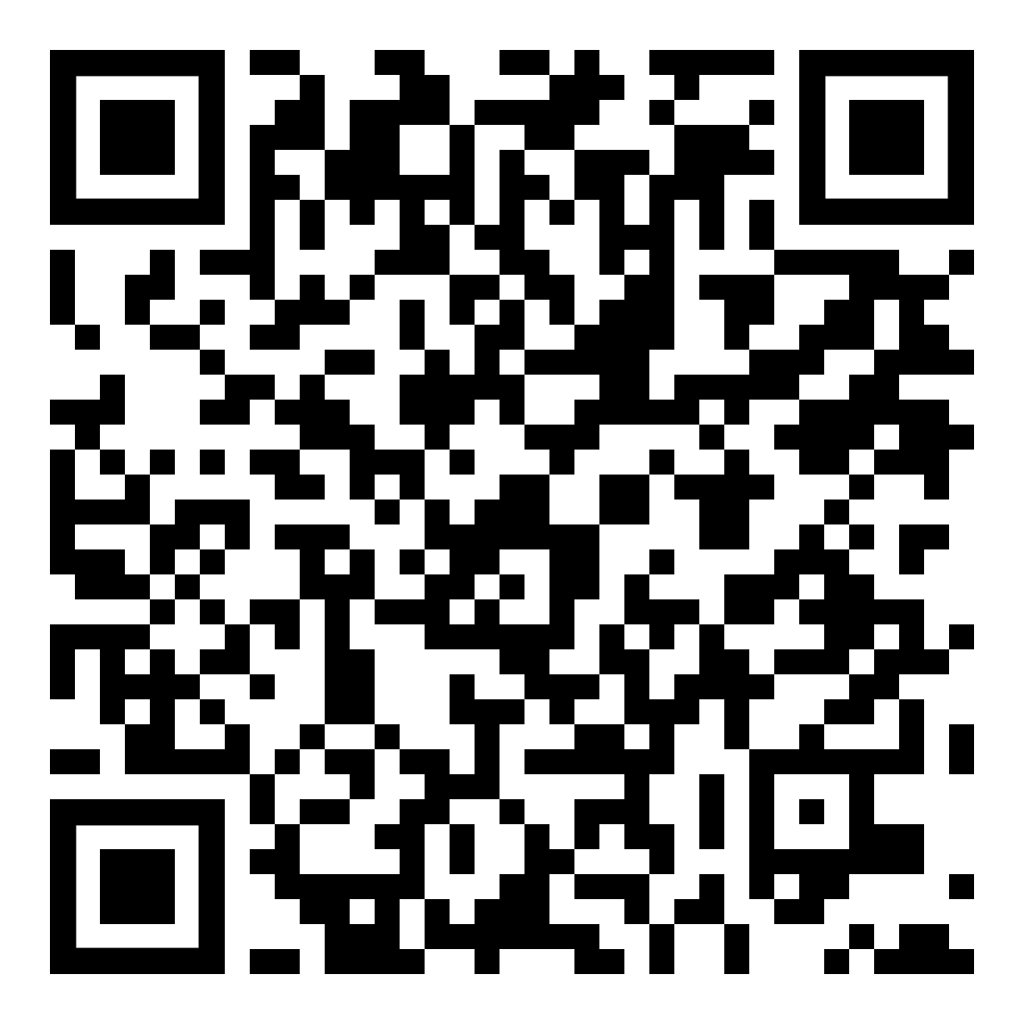
Thank you!
WE VALUE YOUR FEEDBACK!
Please complete the evaluation.
i-phone – just point camera
Android – use QR reader app
Or use this link: https://www.northerndoctors.org.au/education-session-feedback-form/

